Slide 1
Game Design and Engineering

Slide 2
“Most people consider life a battle, but it is not a battle, it is a game.” Shinn (1871-1940)

Slide 3




Slide 4
What is a GAME? But, first what is a not a Game?

Slide 5
Ethics in Games

Slide 6
'not in good taste'
Case 1: http://www.sockandawe.com/
(a game in bad taste – it shows an image of a world leader and one has to throw shoes at it!!)
Case 2: The Dozens – played mostly by African Americans
Case 3: Blue Whale

Slide 7
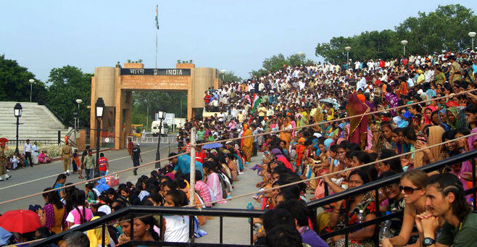
Semblance to ‘the dozens’?

Slide 8
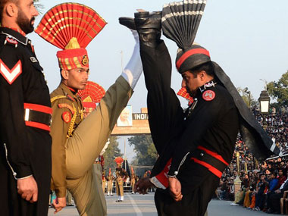
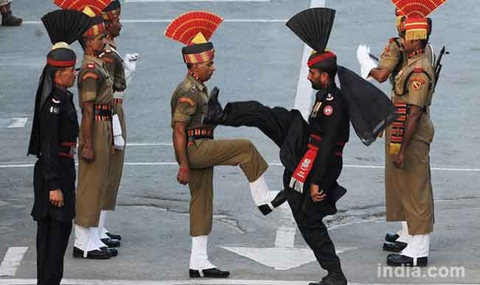

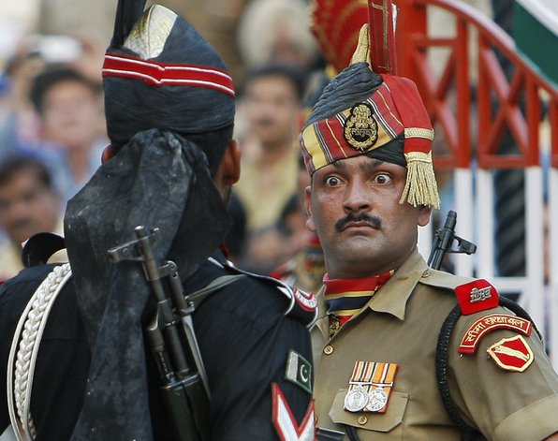
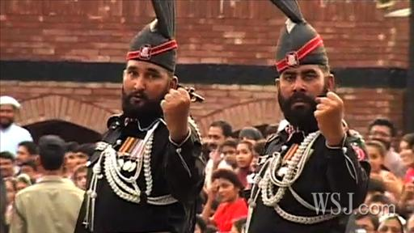

Slide 9
'Disgusting'
1. Custer's Revenge – depiction of rape
2. Torture
3. death

Slide 10
Dangerous
Called the “Game of Chicken
http://www.youtube.com/watch?v=-VZIoT9bzTo
Choking game – played as a rite/ritual to get into elite club.

Slide 11
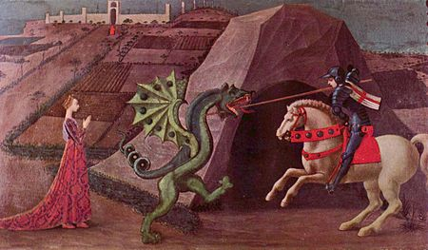
Gender depiction studies
In their 2005 study, Dill and Thill distinguish three major stereotypical depictions of women in gaming: (1) sexualized, (2) scantily clad, and (3) a vision of beauty.[30] The study revealed that over 80% of women in video games represented one of these depictions.
In 2012, a study of the Ohio University showed that the same person playing online on Halo 3 with a male and a female profile using recorded voice messages received 3 times more negative comments with the female profile, despite similar game scores.
In 2012, Sarkeesian was targeted by an online harassment campaign following her launch of a Kickstarter project to fund the Tropes vs. Women in Video Games series.

Slide 12


sport-cult/fanatism-terrorism
The case of the game called “ beatup Anita Sarkeesian”.
When Sarkeesian was scheduled to speak at the 2014 Game Developers Choice Awards, organizers received an anonymous e-mail threatening to detonate a bomb at the ceremony if they did not rescind her award and cancel her speaking engagement. San Francisco police swept the Moscone Center hall and the event proceeded as scheduled.
On October 14, 2014, Sarkeesian and Utah State University received e-mailed terrorist threats to murder Sarkeesian and others attending her planned lecture at the university the following day.

Slide 13
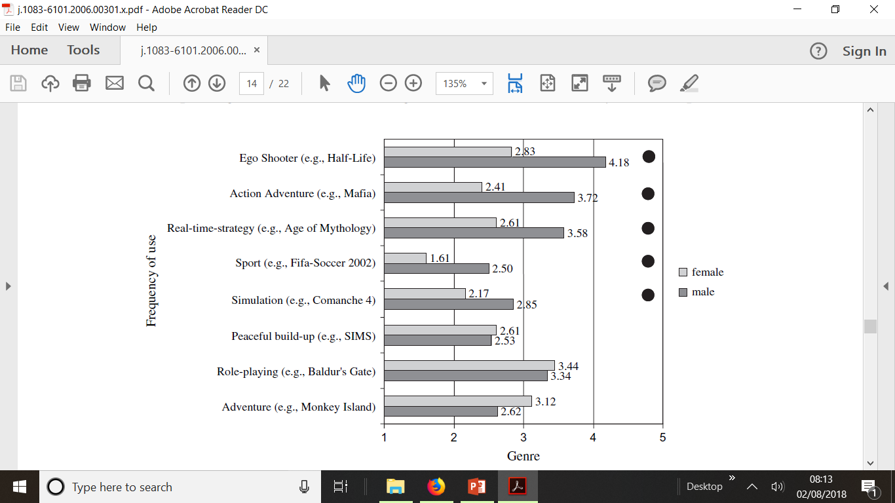
Hartmann and Klimmt, Journal of Computer mediated communication, 2006

Slide 14
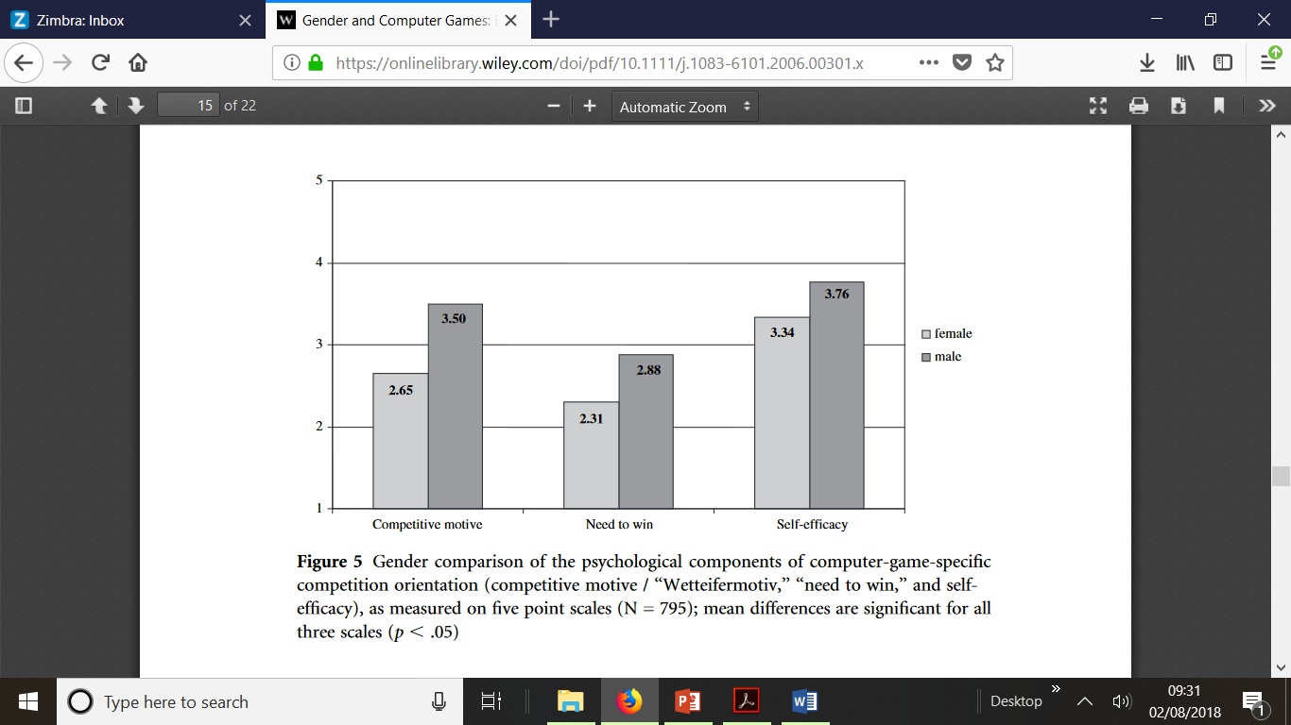
Hartmann and Klimmt, Journal of Computer mediated communication, 2006

Slide 15
Effect of games
Aaron Alexis, the 34-year-old naval contractor who allegedly gunned down 13 people last month at the Navy Yard in Washington D.C. Alexis is said to have spent up to 16 hours per day playing military-themed games like “Call of Duty.”
In Norway, confessed mass murderer Anders Breivik testified in court that he used a virtual “holographic aiming device” from the computer game “Call of Duty: Modern Warfare” to hone his marksmanship skills before embarking on the July 2011 massacre that claimed 77 innocent lives.

Slide 16
What is a Game?
Sensation : Game as sense-pleasure
Fantasy: Game as make-believe
Narrative : Game as drama
Challenge : Game as obstacle course
Fellowship: Game as social framework
Discovery: Game as uncharted territory
Expression: Game as self-discovery
Submission : Game as pastime
https://www.youtube.com/watch?v=DE2R7s5SCSQ

Slide 17
What is a game?
“A game is structured playing, usually undertaken for enjoyment and sometimes used as an educational tool” – Wiki
“In the German language a game is any activity which is executed only for pleasure and without conscious purpose. In this definition every activity that brings pleasure is a game.” Johan Huizinga (Homo Ludens, 1938) and Friedrich Georg Jünger (Die Spiele, 1959).
“ game is an art form” – Adorno (1977)

Slide 18
Game Design covers:
Rules,
Balance,
Strategy,
Complexity, Randomness,
narrative,
Human/player behavior
Skill driven emergent behavior

Slide 19
Game Engineering covers:
Hardware (includes electronics)
Software (game engines, includes OS/Platforms)
Interfacing
Communication
Materials
Fabrication
Usability

